Slide 1
Azure DevCamp Identity and Office 365 APIs

Slide 2
Agenda
Identity Overview
Azure AD
Developing with Office 365
The Microsoft Graph

Slide 3
Oauth and Graph
TBD

Slide 4


Identity as the core of enterprise mobility
Simple connection
Windows Server
Active Directory
Other directories
Self-service
Single sign-on
Azure
SaaS
Public
cloud
On-premises
Microsoft Azure Active Directory
Cloud

Slide 5
Azure Active Directory
90%
of Fortune 500 companies use Microsoft Cloud (Azure, O365, CRM Online, and PowerBI)
Azure AD Directories
>10 M
More than
750 M user accounts on Azure AD
Microsoft “Identity Management as a Service (IDaaS)” for organizations.
Millions of independent identity systems controlled by enterprise and government “tenants.”
Information is owned and used by the controlling organization—not by Microsoft.
Born-as-a-cloud directory for Office 365. Extended to manage across many clouds.
Evolved to manage an organization’s relationships with its customers/citizens and partners (B2C and B2B).
33,000
Enterprise Mobility + Security | Azure AD Premium enterprise customers
>110k third-party applications used with Azure AD each month
>1.3 billion authentications every day on Azure AD
Every Office 365 and Microsoft Azure customer uses Azure Active Directory

Slide 6
Azure AD Graph API
RESTful API
Create, Read, Search, Update & Delete local accounts
OData 3.0 compliant service
Use cases
Migration
Profile lookup & update
Call center / back office apps
User object model
userPrincipalName
signInNames
creationType
passwordPolicies ("DisablePasswordExpiration, DisableStrongPassword“)
linkedAccount: Facebook, Facebook UserID
StrongAuthenticationEmail, StrongAuthenticationPhone
OtherMails
Custom attributes

Slide 7
Link Office 365 and Azure
Log into Microsoft Azure subscription as administrator
Click on the Active Directory link
Click New>Active Directory>Directory>Custom Create
Select to Add an Existing Directory
Follow the steps to add an existing directory
Notes:
It’s not required to link the Office 365 Directory to an Azure subscription
for simply creating provider-hosted apps, but it makes life a bit easier
and opens up the ability to call into Office 365 from other applications.

Slide 8
What is OAuth 2.0?
Simple mechanism to grant a third party access to a user’s resources without sharing the user’s password
Cross platform app authorization
Internet Standard supported by Azure, Facebook, Google, Twitter, and more
Notes:
OAuth provides a simple mechanism for end-users to grant a third party access to their data and resources without sharing their passwords.
It also enables the user to grant access limited by scope and duration.

Slide 9
OAuth 2.0 Tokens
Context Token
Information about the Resources Owner and Client that can be used to get an Access Token later.
Refresh Token
A token used to get an Access Token from the Authorization Server.
Access Token
A token passed to the Resource Server authorizing the Client to access resources.
Authorization Code
A code that can be used to register an app on-the-fly.
Notes:
In the OAuth 2.0 model, access to protected resources is done using access tokens —an object with a specific scope, lifetime, and other access attributes. OAuth access tokens are sometimes compared to valet keys. In the same way as a valet key gives restricted access to a car, allowing a valet to drive it but not open the trunk or the glove compartment, the access token allows a client application restricted access to a user’s data at a resource server via tokens issued by an authorization server in response to the user authorizing access.
With OAuth 2.0, a third-party application does not use the resource owner's credentials to access protected resources. Instead, the third-party application obtains an access token. Access tokens are issued to third-party clients by an authorization server with the approval of the resource owner. The client uses the access token to access the protected resources hosted by the resource server.

Slide 10
Bearer Tokens
OAuth 2.0 Access Tokens are unbound tokens (a.k.a, “Bearer Tokens”)
An Access Token can be used by any application that possesses it
Always use SSL—OAuth design depends on it!
Never expose tokens in JavaScript or allow them to be accessed by client-side debugging tools
If an Access Token is compromised, damage is limited by expiration
If a Refresh Token is compromised, damage is limited because the Client ID and Client Secret are required to get an Access Token from a Refresh Token.

Slide 11

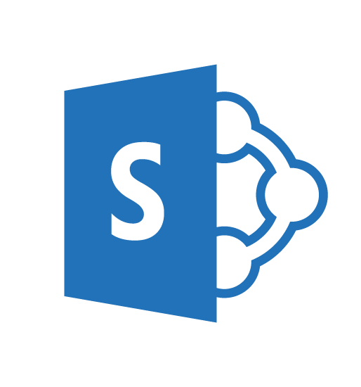
OAuth 2.0 Flow Office 365 APIs
Auth Code,
App Id, App Secret sent
User accesses web application
Access and Refresh
Tokens returned
Azure Web Site
(Client)
Access Token presented
Along with request
Response returned
Consent dialog displayed
Auth Code returned and user redirected
Grant access using Consent Dialog
Redirected to AAD
End User
(Resource Owner)
Azure ACS
(Authorization Server)
SharePoint Online
(Resource Server)

Slide 12
Demo: Register Azure AD Applications
Notes:
Demo the Azure AD portal app registry
Apps.dev.microsoft.com
Azure.com
Manage.windowsazure.com

Slide 13
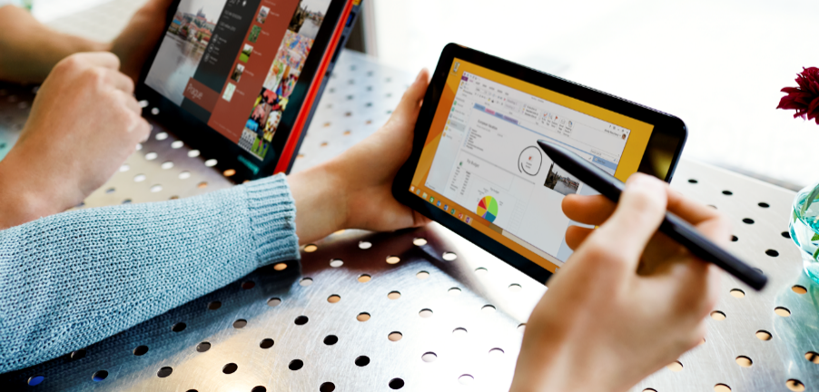

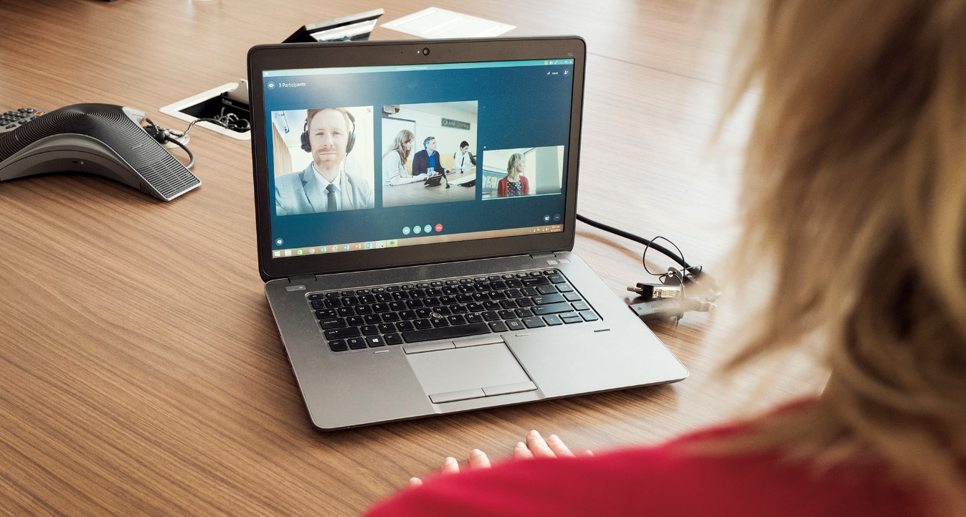
Office Platform
WHAT CAN I BUILD?
ADD-INS AND WEB PARTS:
Make your solution a native part of the modern Office
WEB AND DEVICE APPS:
Build smarter apps by connecting to Office services
VOICE, VIDEO, CONNECTORS, AND BOTS:
Create the next generation of productivity solutions

Slide 14
What’s been GA over the last year?
Azure Active Directory
Outlook mail, calendar and contacts
Office 365 groups and conversations
OneDrive drives and files
WebHooks for Outlook data
SharePoint & LiveID profiles

Slide 15
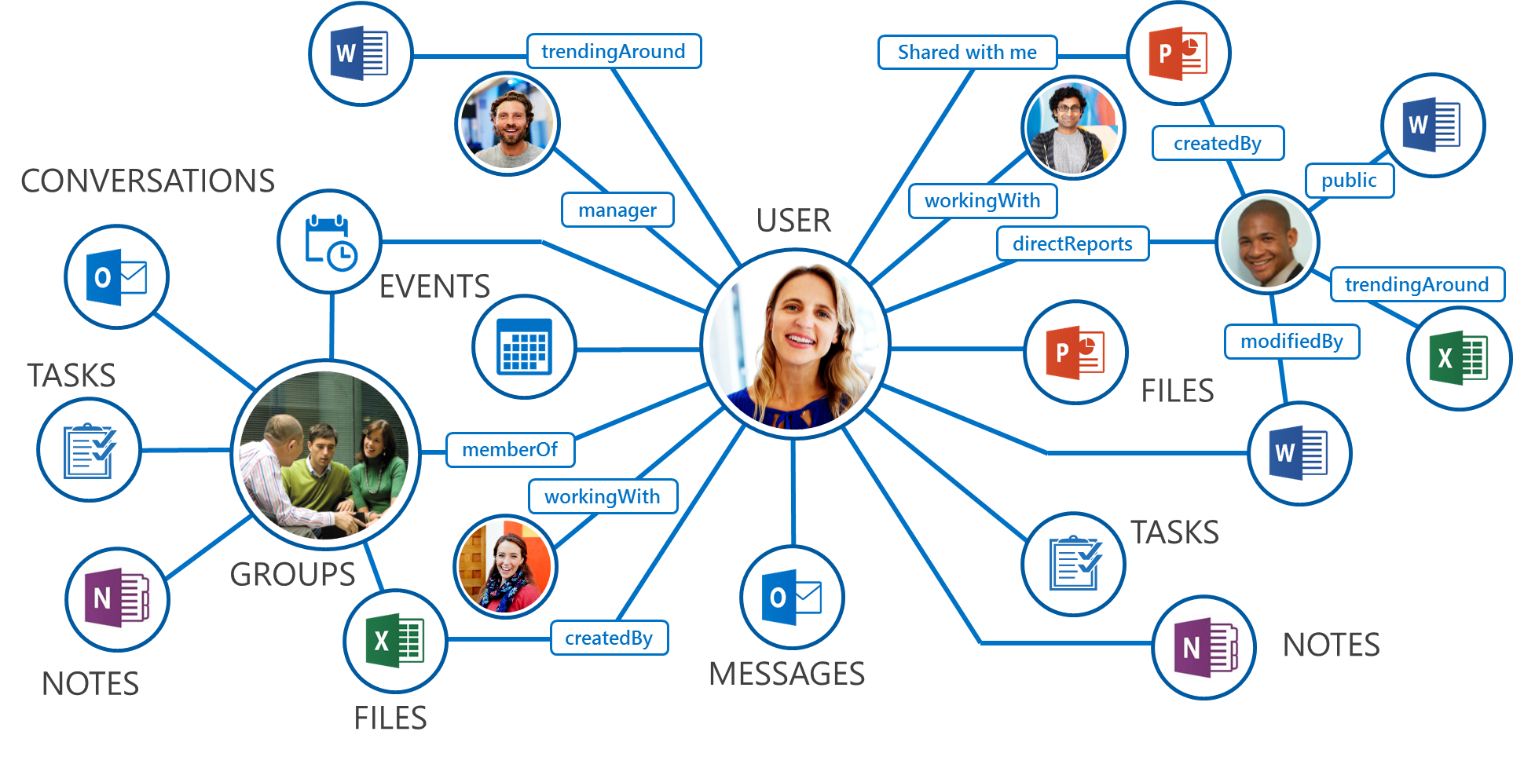
What is Microsoft Graph?
Single API for:
Accessing data
/me, /users, /groups, /messages, /drive, ….
Traversing data
/drive/items/<id>/lastmodifiedByUser
Accessing insights
/insights/trending
Work/School and Personal
https://graph.microsoft.com/

Slide 16
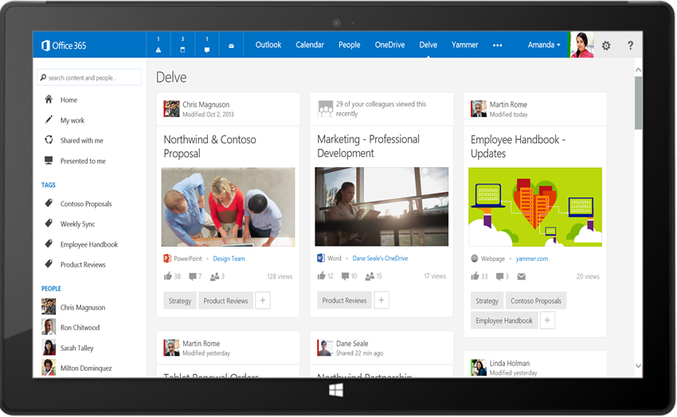
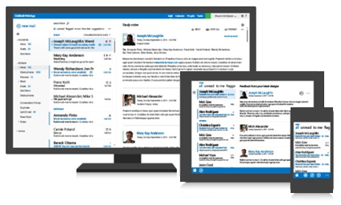




Intelligence in Microsoft Graph
Your App
Microsoft Graph API (graph.microsoft.com)
USERS
GROUPS
FILES
MAIL
CALENDAR
TASKS
Microsoft Graph rich relationships and insights

Slide 17





State of the world before Microsoft Graph
Work and school
Personal
Many different APIs to access data
Separate auth stacks for work and personal

Slide 18
Today’s world with Microsoft Graph
Microsoft Graph
https://graph.microsoft.com
Work and school
Personal
…

Slide 19

Robust Microsoft Graph APIs
Designed for openness and flexibility
Enabling a consistent development platform
Powering a world of devices
https://graph.microsoft.com
Files
Mail
Calendar
People
Search
Office Graph
Groups
Notebooks
Videos
Social

Slide 20
Demo: Authenticate to the Microsoft Graph
Notes:
Demo dev.office.com

Slide 21
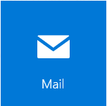

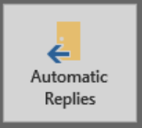


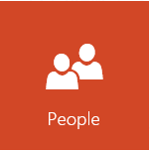
Graph Entities Available for On-Premises Users
Mail
Mail folders
Messages
Item & file attachments
Calendar
Calendar groups & Calendars
Events & Calendar view
Reminders & Reminder view
Contacts
Contact folders
Contacts
Profile
User profile per AAD
Profile picture
Mailbox Settings
Automatic replies
Language & Time zone
Data extensibility
Extended properties

Slide 22
Microsoft Graph API
The best way to connect to OneDrive
One API to learn that
Connects to work, home, and school accounts
Connects to all OneDrive and SharePoint files in the cloud
Connects to Mail, Calendar, Directory, and other Office 365 services

Slide 23
Diverse API styles and endpoints
Azure Active Directory Graph API
https://graph.windows.net/contoso.com/users
https://graph.windows.net/contoso.com/groups
Windows Live profile API
https://apis.live.net/v5.0/me
SharePoint User Profile API
https://contoso.sharepoint.com/_api/SP.UserProfiles.PeopleManager/GetMyProperties
Exchange HD Picture API
https://graph.microsoft.com/v1.0/me/photo
Outlook REST API
https://outlook.office.com/api/v2.0/me/Messages
https://outlook.office.com/api/v2.0/me/Events
Office Graph in SharePoint Online
https://contoso.sharepoint.com/_api/search/query?Querytext='*'&Properties='GraphQuery:actor(ME,action\:1020,or(action\:1020\,action\:1003,action\:1001,action\:1024,action\:1005,action\:1037,action\:1039,action\:1036)'&SelectProperties='Docid,Title
OneDrive for Business API
https://contoso-my.sharepoint.com/personal
/yina_contoso_com/_api/v2.0/drive
https://contoso.sharepoint.com/sites
/designCouncil/_api/v2./drive
OneDrive API
https://api.onedrive.com/v1.0/drive

Slide 24
Unified API style – single endpoint
https://graph.microsoft.com
Operation | Service endpoint
GET my profile | https://graph.microsoft.com/v1.0/me
GET my files | https://graph.microsoft.com/v1.0/me/drive/root/children
GET my photo | https://graph.microsoft.com/v1.0/me/photo/$value
GET my mail | https://graph.microsoft.com/v1.0/me/messages
GET my calendar | https://graph.microsoft.com/v1.0/me/calendar
GET my manager | https://graph.microsoft.com/v1.0/me/manager
GET last user to modify file foo.txt | https://graph.microsoft.com/v1.0/me/drive/root/children/foo.txt/lastModifiedByUser
GET users in my organization | https://graph.microsoft.com/v1.0/users
GET group conversations | https://graph.microsoft.com/v1.0/groups/<id>/conversations
GET people related to me | https://graph.microsoft.com/beta/me/people
GET my tasks | https://graph.microsoft.com/beta/me/tasks
GET my notes | https://graph.microsoft.com/beta/me/notes/notebooks
GET files trending around me | https://graph.microsoft.com/beta/me/insights/trending

Slide 25
Office 365 files are…
OneDrive Personal
OneDrive for Business
SharePoint
Cloud storage for personal documents, photos, and files
Accessible from everywhere
Best for personal, user owned content
Basic collaboration and broad file accessibility
Secure enterprise grade storage for business documents and files.
Best for individual enterprise owned content
Basic collaboration and sharing
Store business files that need broad organizational accessibility
Advanced collaboration support and workflows
Connect to everything! You never know where that file will be stored.

Slide 26
Profile API
Get and update your own profile information
The /me API allows you to get and update your own profile information regardless of where different properties are stored.
Get profile information about other users
The /users API allows you to get information about other users in your tenancy.
See how people are related
Traverese the organisation structure using manager and directReports
manager
/me /users
directReports

Slide 27
Profile API demo – Experience and API
graph.microsoft.com/v1.0/
GET /me?$select=displayName,aboutMe,jobTitle,skills
PATCH /me
GET /me/manager
GET /users/{id}
GET /users/{id}/manager
GET /users/{id}/directReports

Slide 28
Demo: Query the graph

Slide 29
People API demo – Experience and API
graph.microsoft.com/beta/
/me/people?$top=50&$select=displayName
/me/people?$search="John"
/me/people?$seach="topic:api"
/me/people? ?$filter=sources/any(source:source/type eq 'Directory')
/users/{id}/people

Slide 30
Provisioning Sites with CSOM
var tenant = new Tenant(clientContext);
var spoOperation = tenant.CreateSite(new SiteCreationProperties {
Url ="https://<tenant>.sharepoint.com/sites/<siteName>", Owner = "user@tenant.com", Template = "BLANKINTERNETCONTAINER#0", Title = "Contoso Property Management Dashboard", StorageMaximumLevel = 1000, StorageWarningLevel = 750, TimeZoneId = 7, UserCodeMaximumLevel = 550, UserCodeWarningLevel = 500
});
clientContext.Load(spoOperation);
clientContext.ExecuteQuery();

Slide 31
Provisioning Groups with Graph
var g = new Group {
DisplayName = "My Group",
MailNickname = "MyGroup",
SecurityEnabled = false,
MailEnabled = true,
Description = "A nice group",
GroupTypes = new[] { "Unified" },
};
g = await graphService.Groups.Request().AddAsync(g);

Slide 32
What can I do with OneDrive?
Connect to the files where they live
Access to metadata + content on Mobile and Web
Sync files to your devices
Share files with ease
Rich thumbnails and previews
Quickly integrates with your apps through pickers and APIs
Find the most relevant files with Delve insights
Build a compliant app on Office 365
Store your app data in SharePoint or OneDrive and get Office 365 benefits like compliance, auditing, enterprise sharing
AAD enables advanced security like multi-factor auth

Slide 33
OneDrive in Microsoft Graph API
The best way to connect to OneDrive
One API to integrate with the breadth of Office 365
Same authentication for work, home, and school
See https://graph.microsoft.io for details

Slide 34
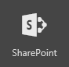
Read data from existing SharePoint site
GET https://graph.microsoft.com/beta/sites/ {siteId}/lists/{listId}/items?expand=columnSet
{ "value":[ {
"createdBy": { "user" : {"id":"d54e4cdd-d2ca-4c39-bfa5-35895bca12f0","displayName":"Gareth"}},
"createdDateTime":"2016-09-20T08:16:21Z",
"eTag":"1610ac6a-24f6-4458-9733-1e5977c63caa,1",
"id":"1610ac6a-24f6-4458-9733-1e5977c63caa",
"lastModifiedBy":{"user":{"id":"d54e4cdd-d2ca-4c39-bfa5-35895bca12f0","displayName":"Gareth"}},
"lastModifiedDateTime":"2016-09-0T08:16:21Z",
"webUrl":"https://site.sharepoint.com/sites/SuiteLevelAppDemo/Lists/NewHireTasks/1_.000",
"listItemId":1,
"columnSet":{
"Title":"Set up payroll details",
"Description":"Set up your payroll details for direct payment of your salary.",
"id":"1",
...
} }]}

Slide 35
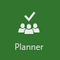
Create a plan for new employee tasks
POST https://graph.microsoft.com/beta/plans
{
"title" : "My plan with Bob",
"owner" : "<groupIdGuid>"
}
POST https://graph.microsoft.com/beta/buckets
{
"name" : "Urgent",
"planId" : "<planId>" // From response to previous call
}

Slide 36
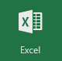
Update latest timesheet data
GET https://graph.microsoft.com/1.0/me/drive/
items/<id>/workbook/worksheets
PATCH https://graph.microsoft.com/beta/me/drive/
items/{itemId}/workbook/worksheets('Time')/ range(address='a2:c2')
{
…
"values": [ ["EmployeeHours", "March", "32.0"]],
"valueTypes": [ ["String", "String", "Double"]],
…
}

Slide 37

API Documentation
We want the industry’s best API documentation
Our API docs are open source on GitHub.
Automated testing
Every change to the docs is tested w/ the service to ensure the docs are accurate
Every change to our service is tested to verify it doesn’t break the docs
Documentation continuous integration powered by AppVeyor and/or VSO
We’re bringing this to Graph API and other teams across the company
If something isn’t great, let us know (or better yet, send a pull request)

Slide 38
Cross Office Workflow Apps
Graph API
Use Cases
App accesses data from multiple workloads: contacts, calendars, email and files stored across Office 365 services
App wants to use our analytics engine to delve into relationships between items across these services
Example
Delve
Feature: Microsoft Graph, Office Graph service
Learn more: https://graph.microsoft.io/

Slide 39
OneDrive API demo
Permissions and App Tokens
https://github.com/rgregg/onedrive-app-delegate-sample

Slide 40
Simple file access apps
OneDrive / Graph API
Picker SDK
Use cases
Quickly import/download files stored in OneDrive
Publish local files to OneDrive for sharing and collaboration
Example
Trello (attach a link to a card)
Smartsheet (embed a document from OneDrive)
OneDrive File Picker SDK
iOS, Android, .NET and JavaScript supported

Slide 41
OneDrive File Pickers demo
Markdown Editor for OneDrive
https://github.com/rgregg/onedrive-markdown-editor-sample

Slide 42
Questions?

